Slide 1
Aerial Application
A Vital Component
of Production Agriculture

Slide 2
About NAAA
The National Agricultural Aviation Association (NAAA) works to support the agricultural aviation industry through:
Educational
Services
Public
Outreach
Government Relations
Networking
Industry
Affairs

Slide 3
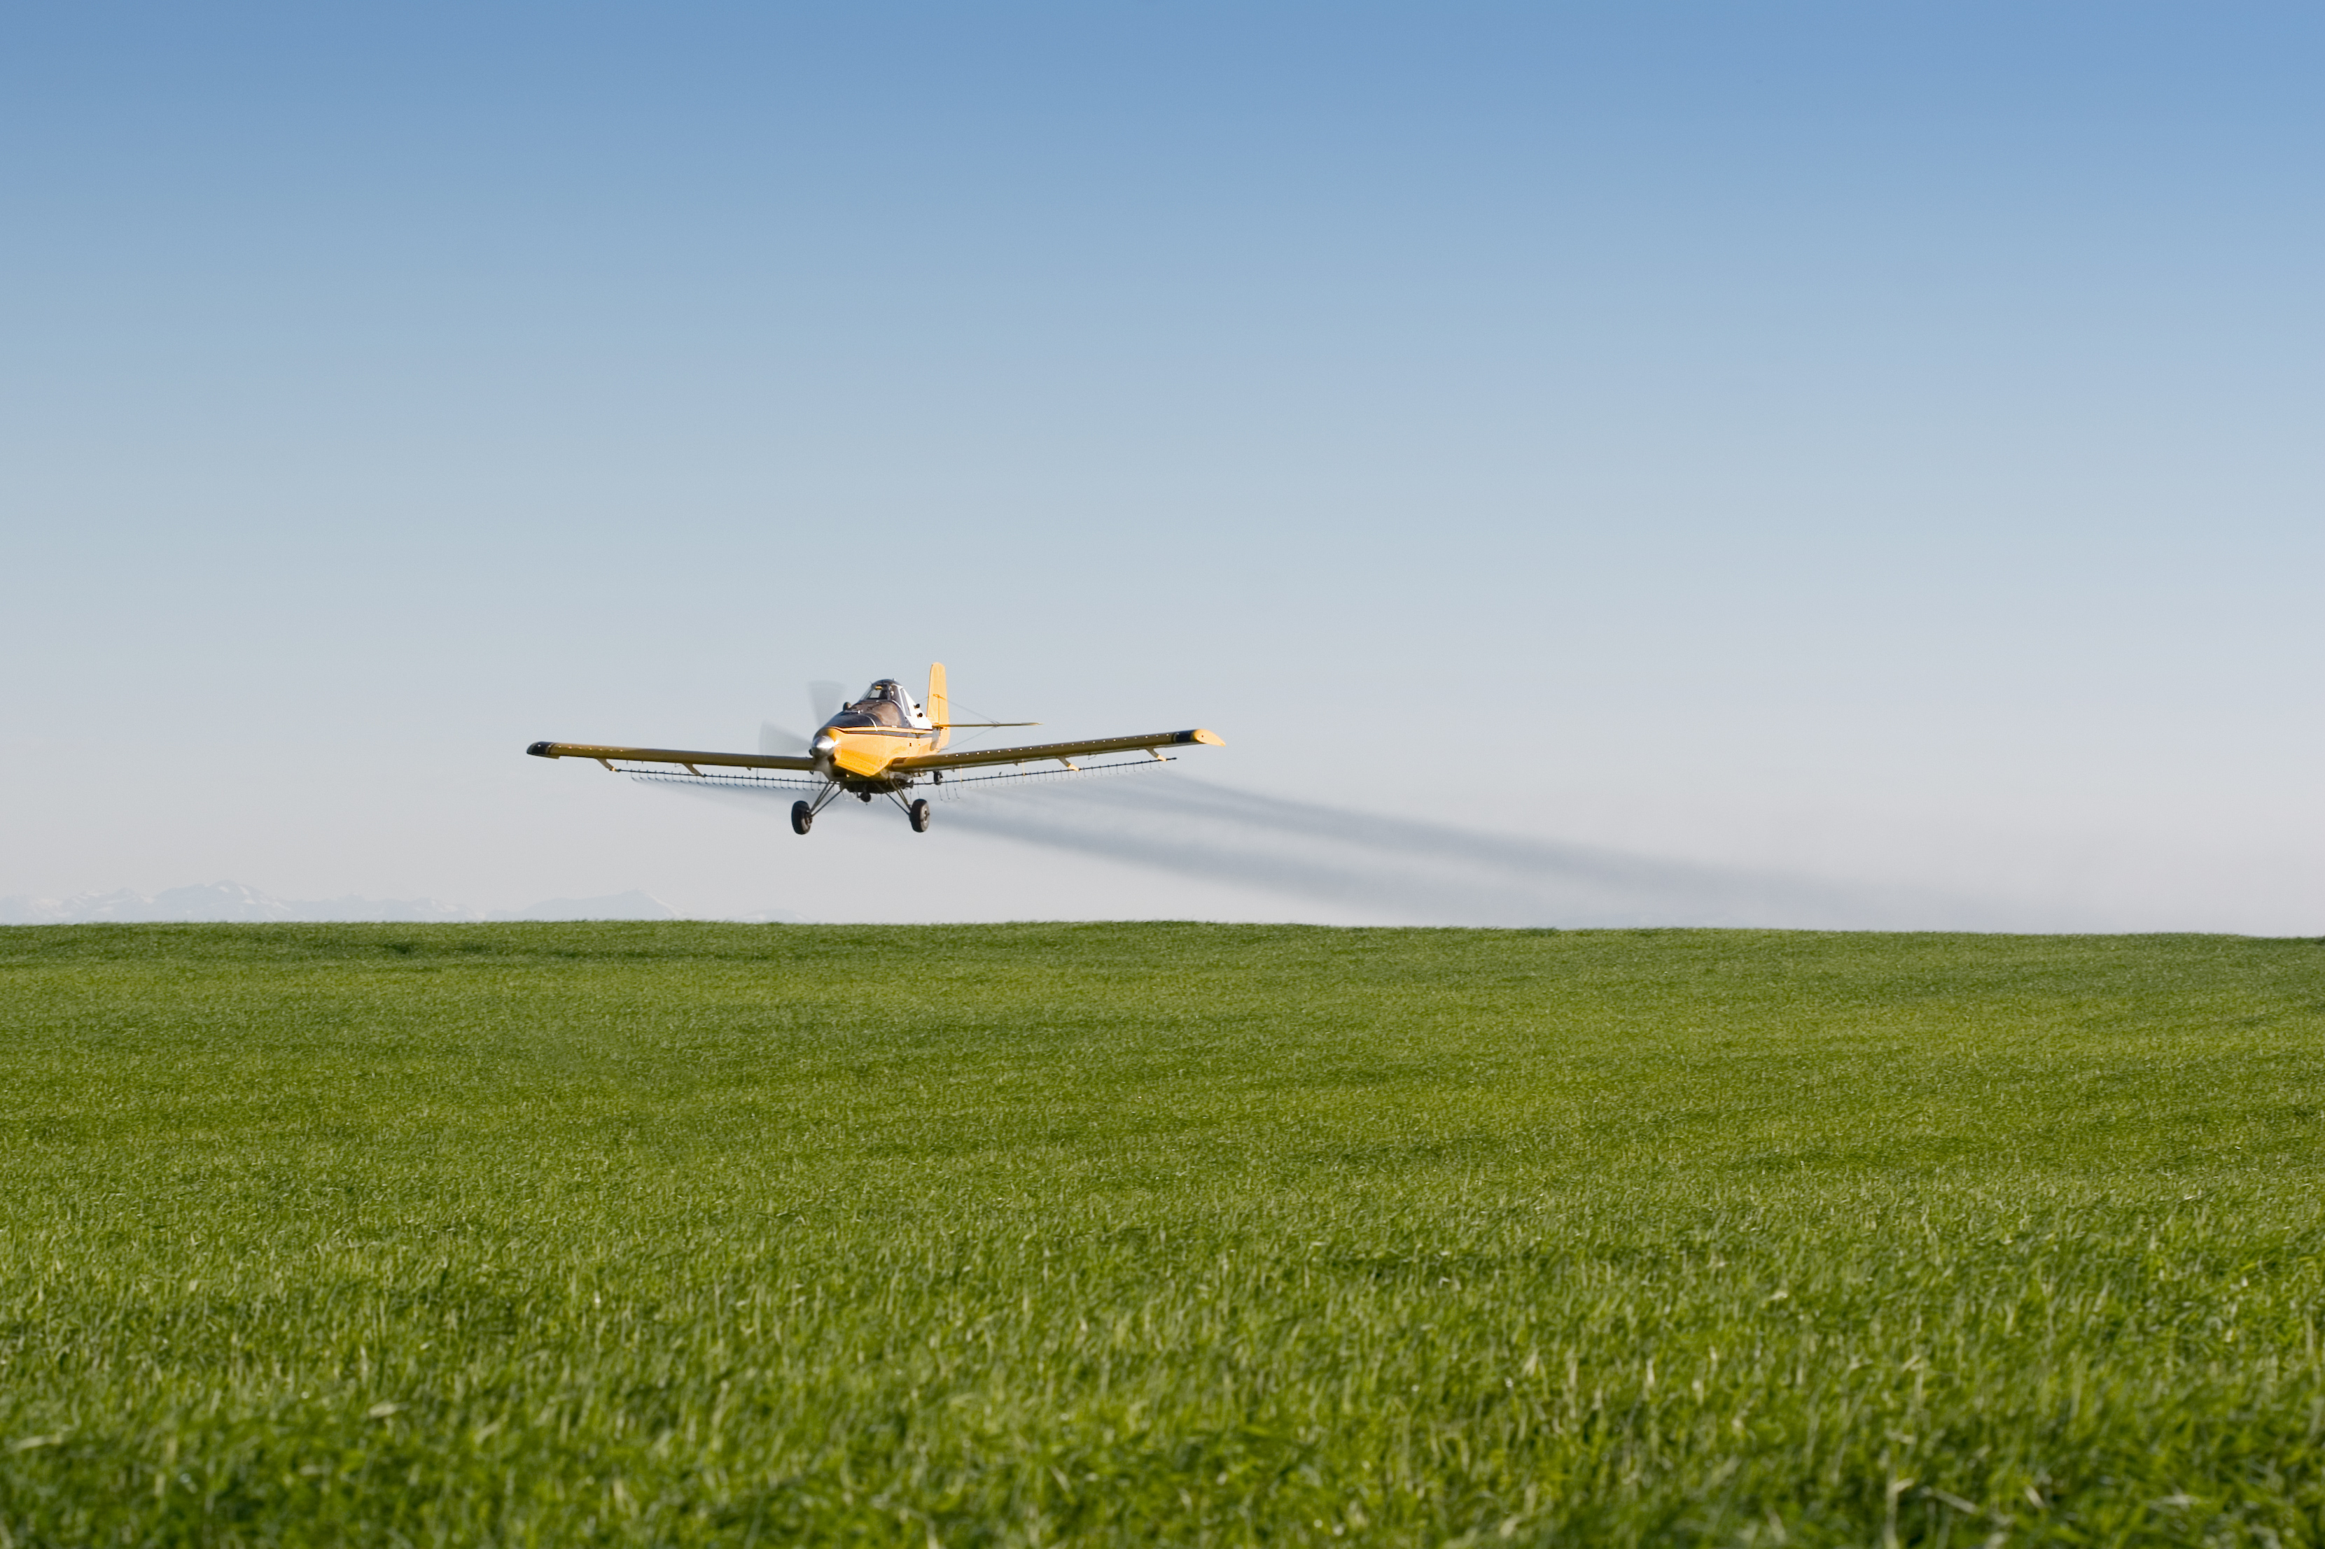
What is Aerial Application?
+
Precision Application
Low-altitude Aviation
Notes:
The use of airplanes and helicopters to seed, fertilize and treat crops with protective products to control weeds, insects and fungi. It is used on both organic and conventional cropland. Aerial application is also used to treat forestland, rangeland and pastureland for grazing livestock, to control disease-carrying pests like mosquitoes, and to fight fires.

Slide 4
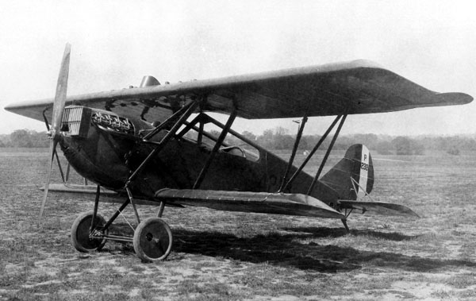
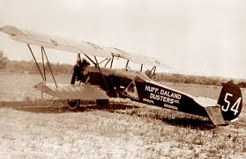
Aerial Application History
1921
World’s 1st Aerial Application
Lt. John Macready spread lead arsenate dust over catalpa trees in Ohio
1923
1st Commercial Application
By Huff-Daland Dusters, Inc. – the forerunner to Delta Air Lines

Slide 5
Why is Aerial Application Important?
Notes:
Fastest way to treat (3-4 times faster than other application forms).
Important when application is needed within a narrow timeframe.
Pest Resistance can be addressed by aerial’s ability to treat in multiple conditions; allowing for the application to be made at the most precise, efficacious window.
Aerial application can reach remote, hard to reach areas, i.e. wet soil, rolling terrain inoperable to other forms of application.
Also treats above crop canopy not driving through it compacting soil and damaging plant. Aerial can result in 5% greater yields.
Can treat wet soil, rolling hills and other terrain that other forms of application cannot.

Slide 6
Benefits of Aerial Application
Aerial Applicators help feed, clothe and fuel the world
Food
Fiber
Biofuel
Public Health

Slide 7
Benefits of Aerial Application
127
Million
Acres
Flying for Your Food
The agricultural aviation industry treats 127 million acres of cropland each year
Notes:
This equates to just under 20% (18.75%) of U.S. commercial cropland that is treated by air.

Slide 8
Benefits of Aerial Application
Flying for Fiber
Texas is the United States’ leading producer of cotton
Notes:
Aerial application is crucial to producing these crops because it allows mature cotton plants to receive critical applications without damaging the plants.
Source: http://www.cotton.org/edu/faq/

Slide 9
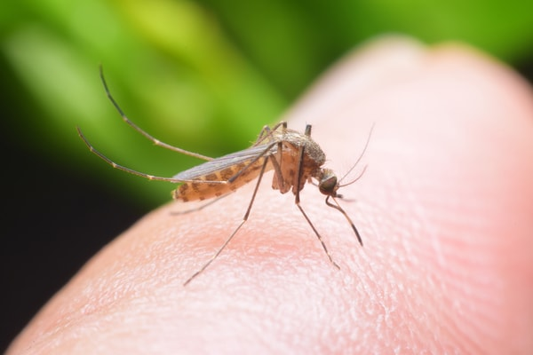
Benefits of Aerial Application
Flying for Your Health
Aerial applicators control mosquitos and other health-threatening pests, which carry diseases like Zika and West Nile Virus

Slide 10
Benefits of Aerial Application
Flying for Biofuel
Ethanol is a grain alcohol that can be blended with gasoline and used in motor vehicles. Most of the ethanol made in the U.S. comes from corn.
Notes:
Aerial application is crucial to producing these crops because it allows mature cotton plants to receive critical applications without damaging the plants.
Source: https://web.extension.illinois.edu/ethanol/

Slide 11
Benefits of Aerial Application
Nearly 100% of all applied forest protection products are applied by air
Aerial Applicators also assist with fire suppression
Notes:
There is no other alternative for making applications to forests. If it were not for aerial application, our forests would face potential destruction from pests.

Slide 12
Benefits of Aerial Application
Both organic and conventional crops need fertilizers applied and pests controlled, they just use different types of pesticides.

Slide 13
Benefits of Aerial Application
The five most common aerially treated crops are:
Corn
Wheat/Barley
Soybeans
Pastures/Rangeland
Alfalfa
Notes:
Also treat a wide range of other crops including Cotton, Rice, Potatoes, Forests, Leafy Vegetables, Orchards, Fruit/nut trees, Pastures, Rangeland, Rice, Roots and
Tubers, Small fruits, Grapes/berries and Small Grains

Slide 14
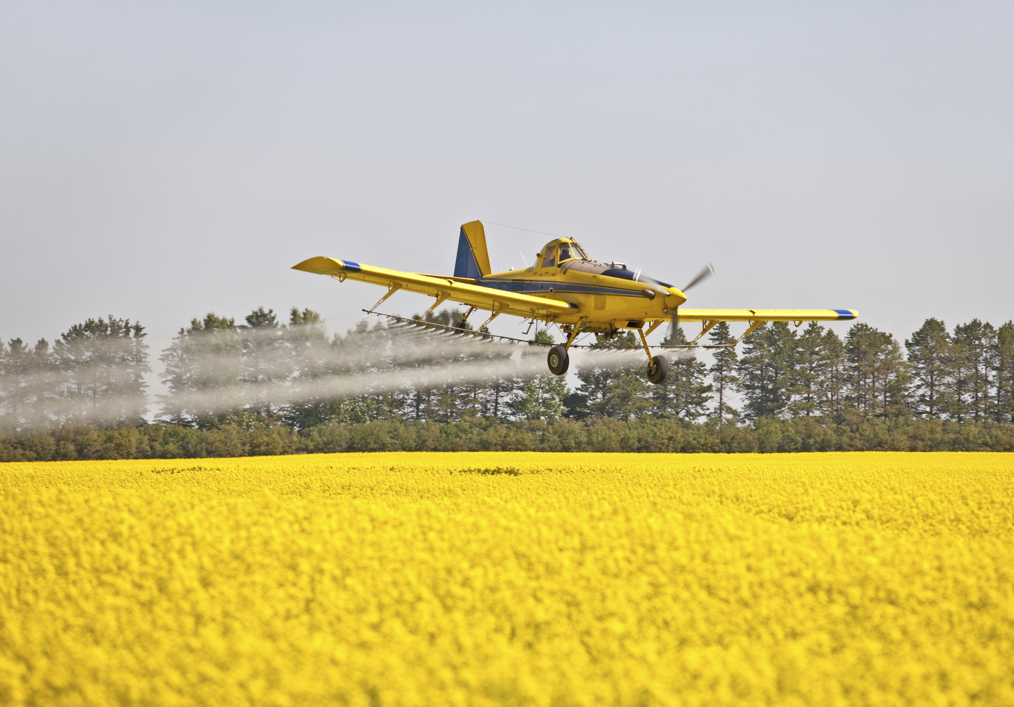
Benefits of Aerial Application
Treating crops by air prevents damage to the crop and soil that can occur when treating the crop with ground equipment
Notes:
Research by Purdue University has shown that wheel track damage caused by application with a ground rig can reduce yield by up to 4.9 percent in soybeans.

Slide 15
Benefits of Aerial Application
Allows for greater harvest yields of crops, resulting in preservation of natural ecosystems

Slide 16
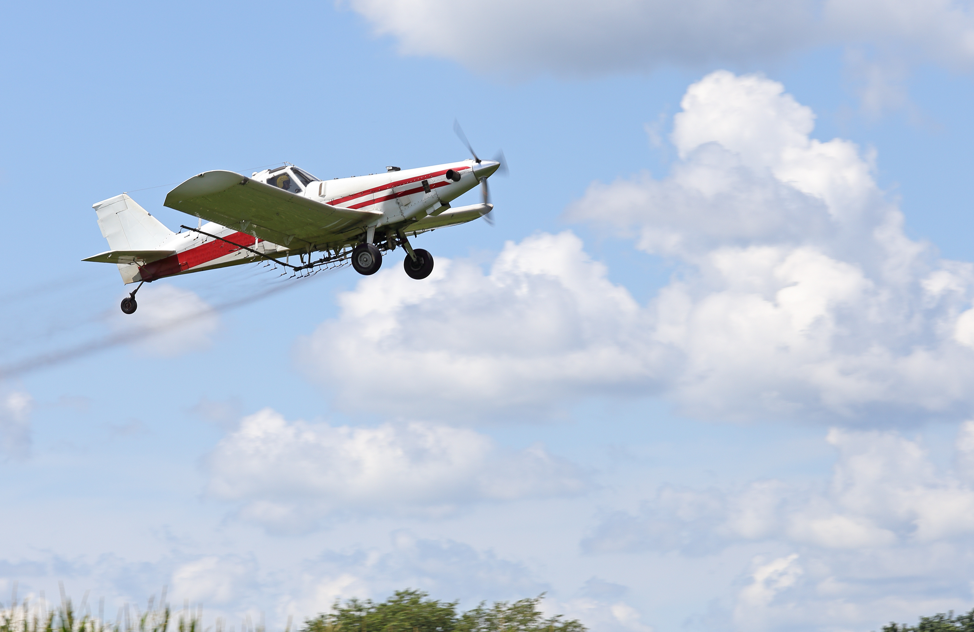
Benefits of Aerial Application
It’s the fastest and most economical way to treat crops
Notes:
Fastest way to treat (3-4 times faster than other application forms).
Important when application is needed within a narrow timeframe.
Pest Resistance can be addressed by aerial’s ability to treat in multiple conditions; allowing for the application to be made at the most precise, efficacious window.
Aerial application can reach remote, hard to reach areas, i.e. wet soil, rolling terrain inoperable to other forms of application.
Also treats above crop canopy not driving through it compacting soil and damaging plant. Aerial can result in 5% greater yields.
Can treat wet soil, rolling hills and other terrain that other forms of application cannot.

Slide 17
Benefits of Aerial Application
9.8 Billion
People to Feed
by 2050
Notes:
The current world population is 7.6 billion as of June 2018 according to the most recent United Nations estimates elaborated by Worldometers.

Slide 18
Industry Outlook

Slide 19
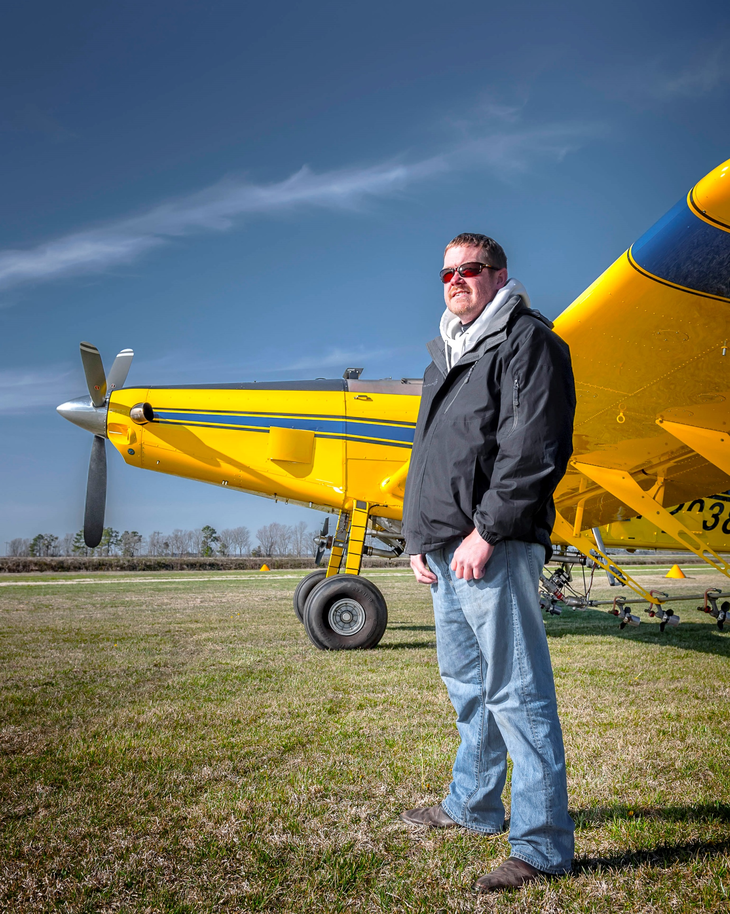
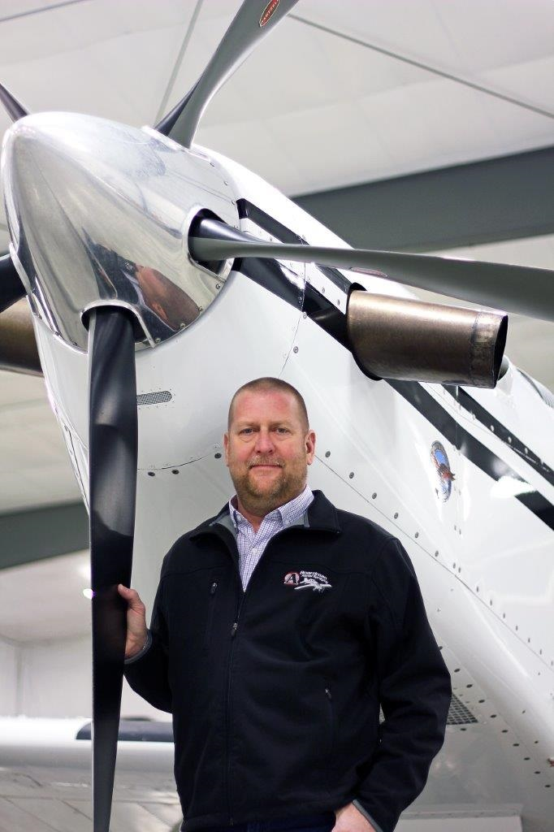
Industry Outlook
Approximately 3,840 ag pilots in the United States

Slide 20
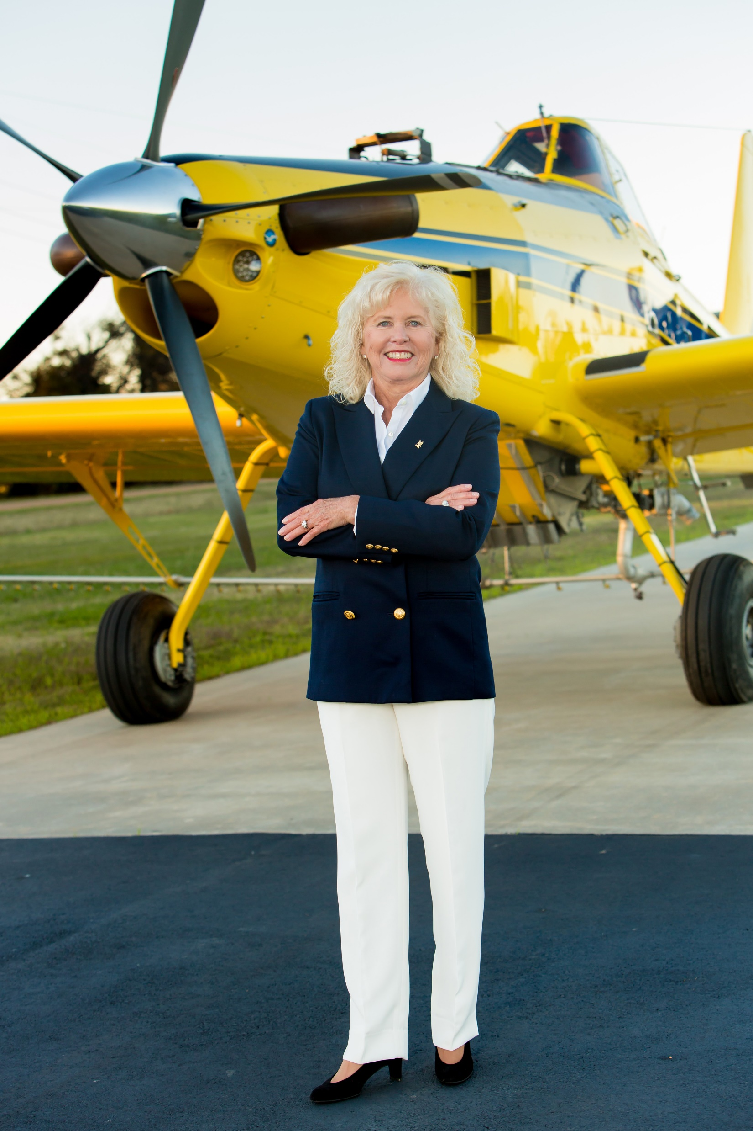
Industry Outlook
87% of aerial application business owners are also pilots
Aerial application is conducted in all 50 states in the U.S. and several other countries

Slide 21
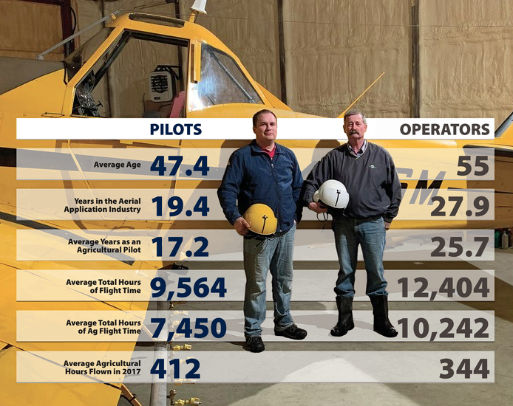
Industry Outlook
Notes:
The average Part 137 Operator is 53 years old, whereas the average age of an ag pilot is 49.9 years old
In 2010, the average number of agricultural hours flown by an ag pilot was 396 hours and by an operator 333 hours
The average total flight time for an operator is 12,336 hours and 10,997 hours by an ag pilot
The average number of years in the agricultural industry for an operator is 27.4 years and 21.3 years for an ag pilot

Slide 22
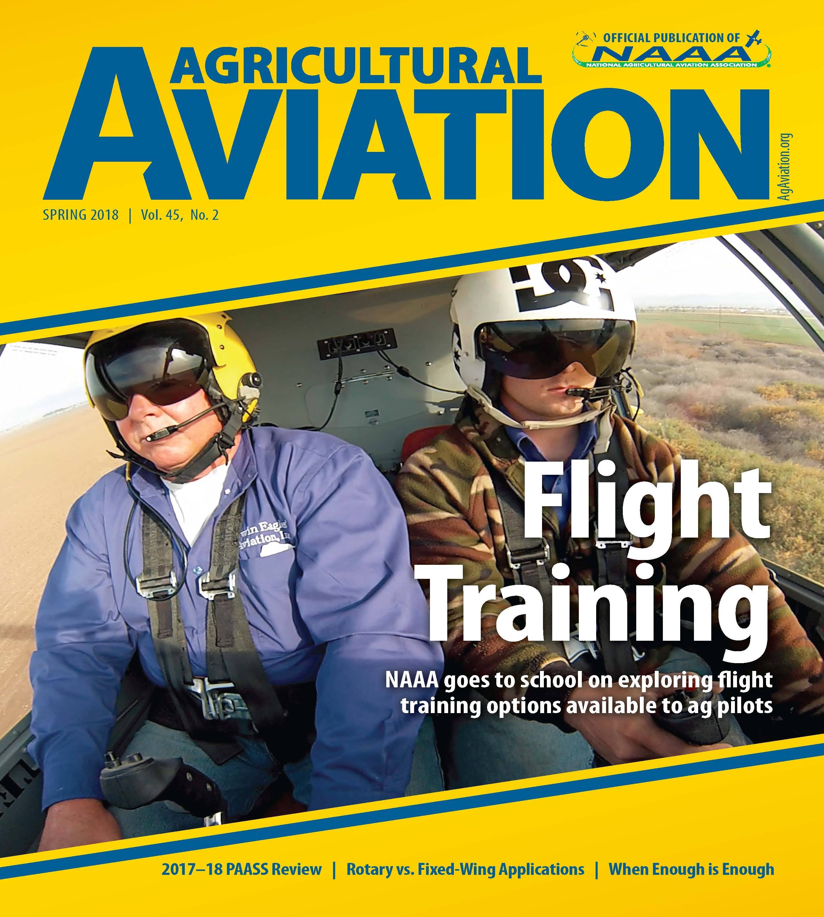
Ag Pilot Qualifications
The average aerial applicator has over 20 years of industry experience
Ag pilots have their commercial pilots’ licenses and must also be registered as commercial pesticide applicators in the states which they make applications
Aerial applicators must hold the Federal Aviation Administration Part 137 Certificate or work under someone who holds the certificate which allows for low-level agricultural aviation

Slide 23
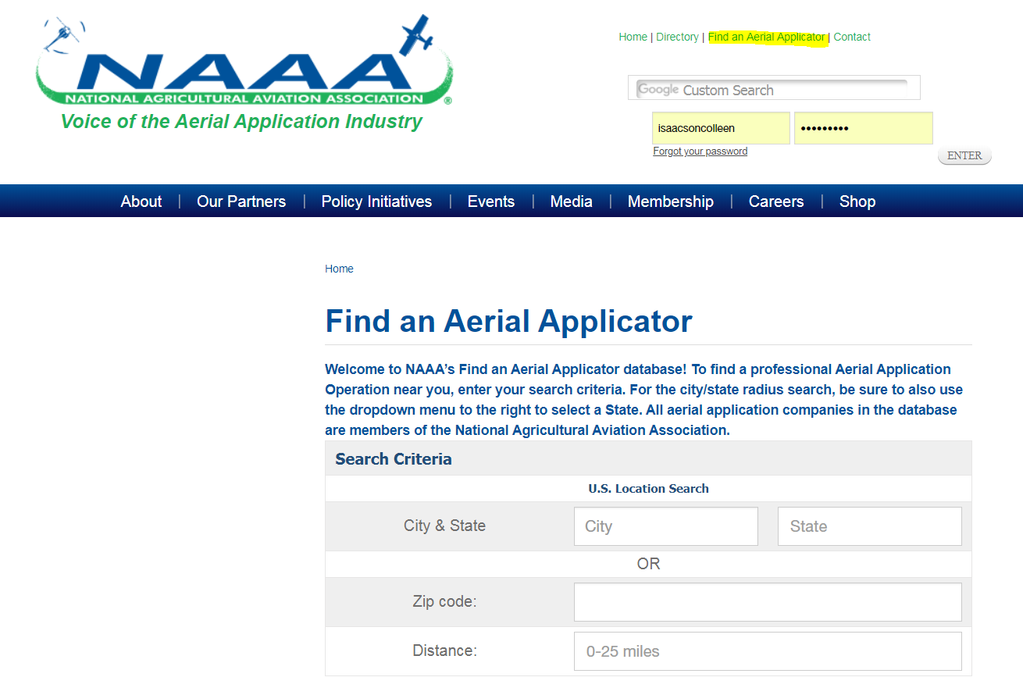
Find an Aerial Applicator
Visit AgAviation.org to find an aerial applicator in your area

Slide 24
Agricultural Aircraft

Slide 25
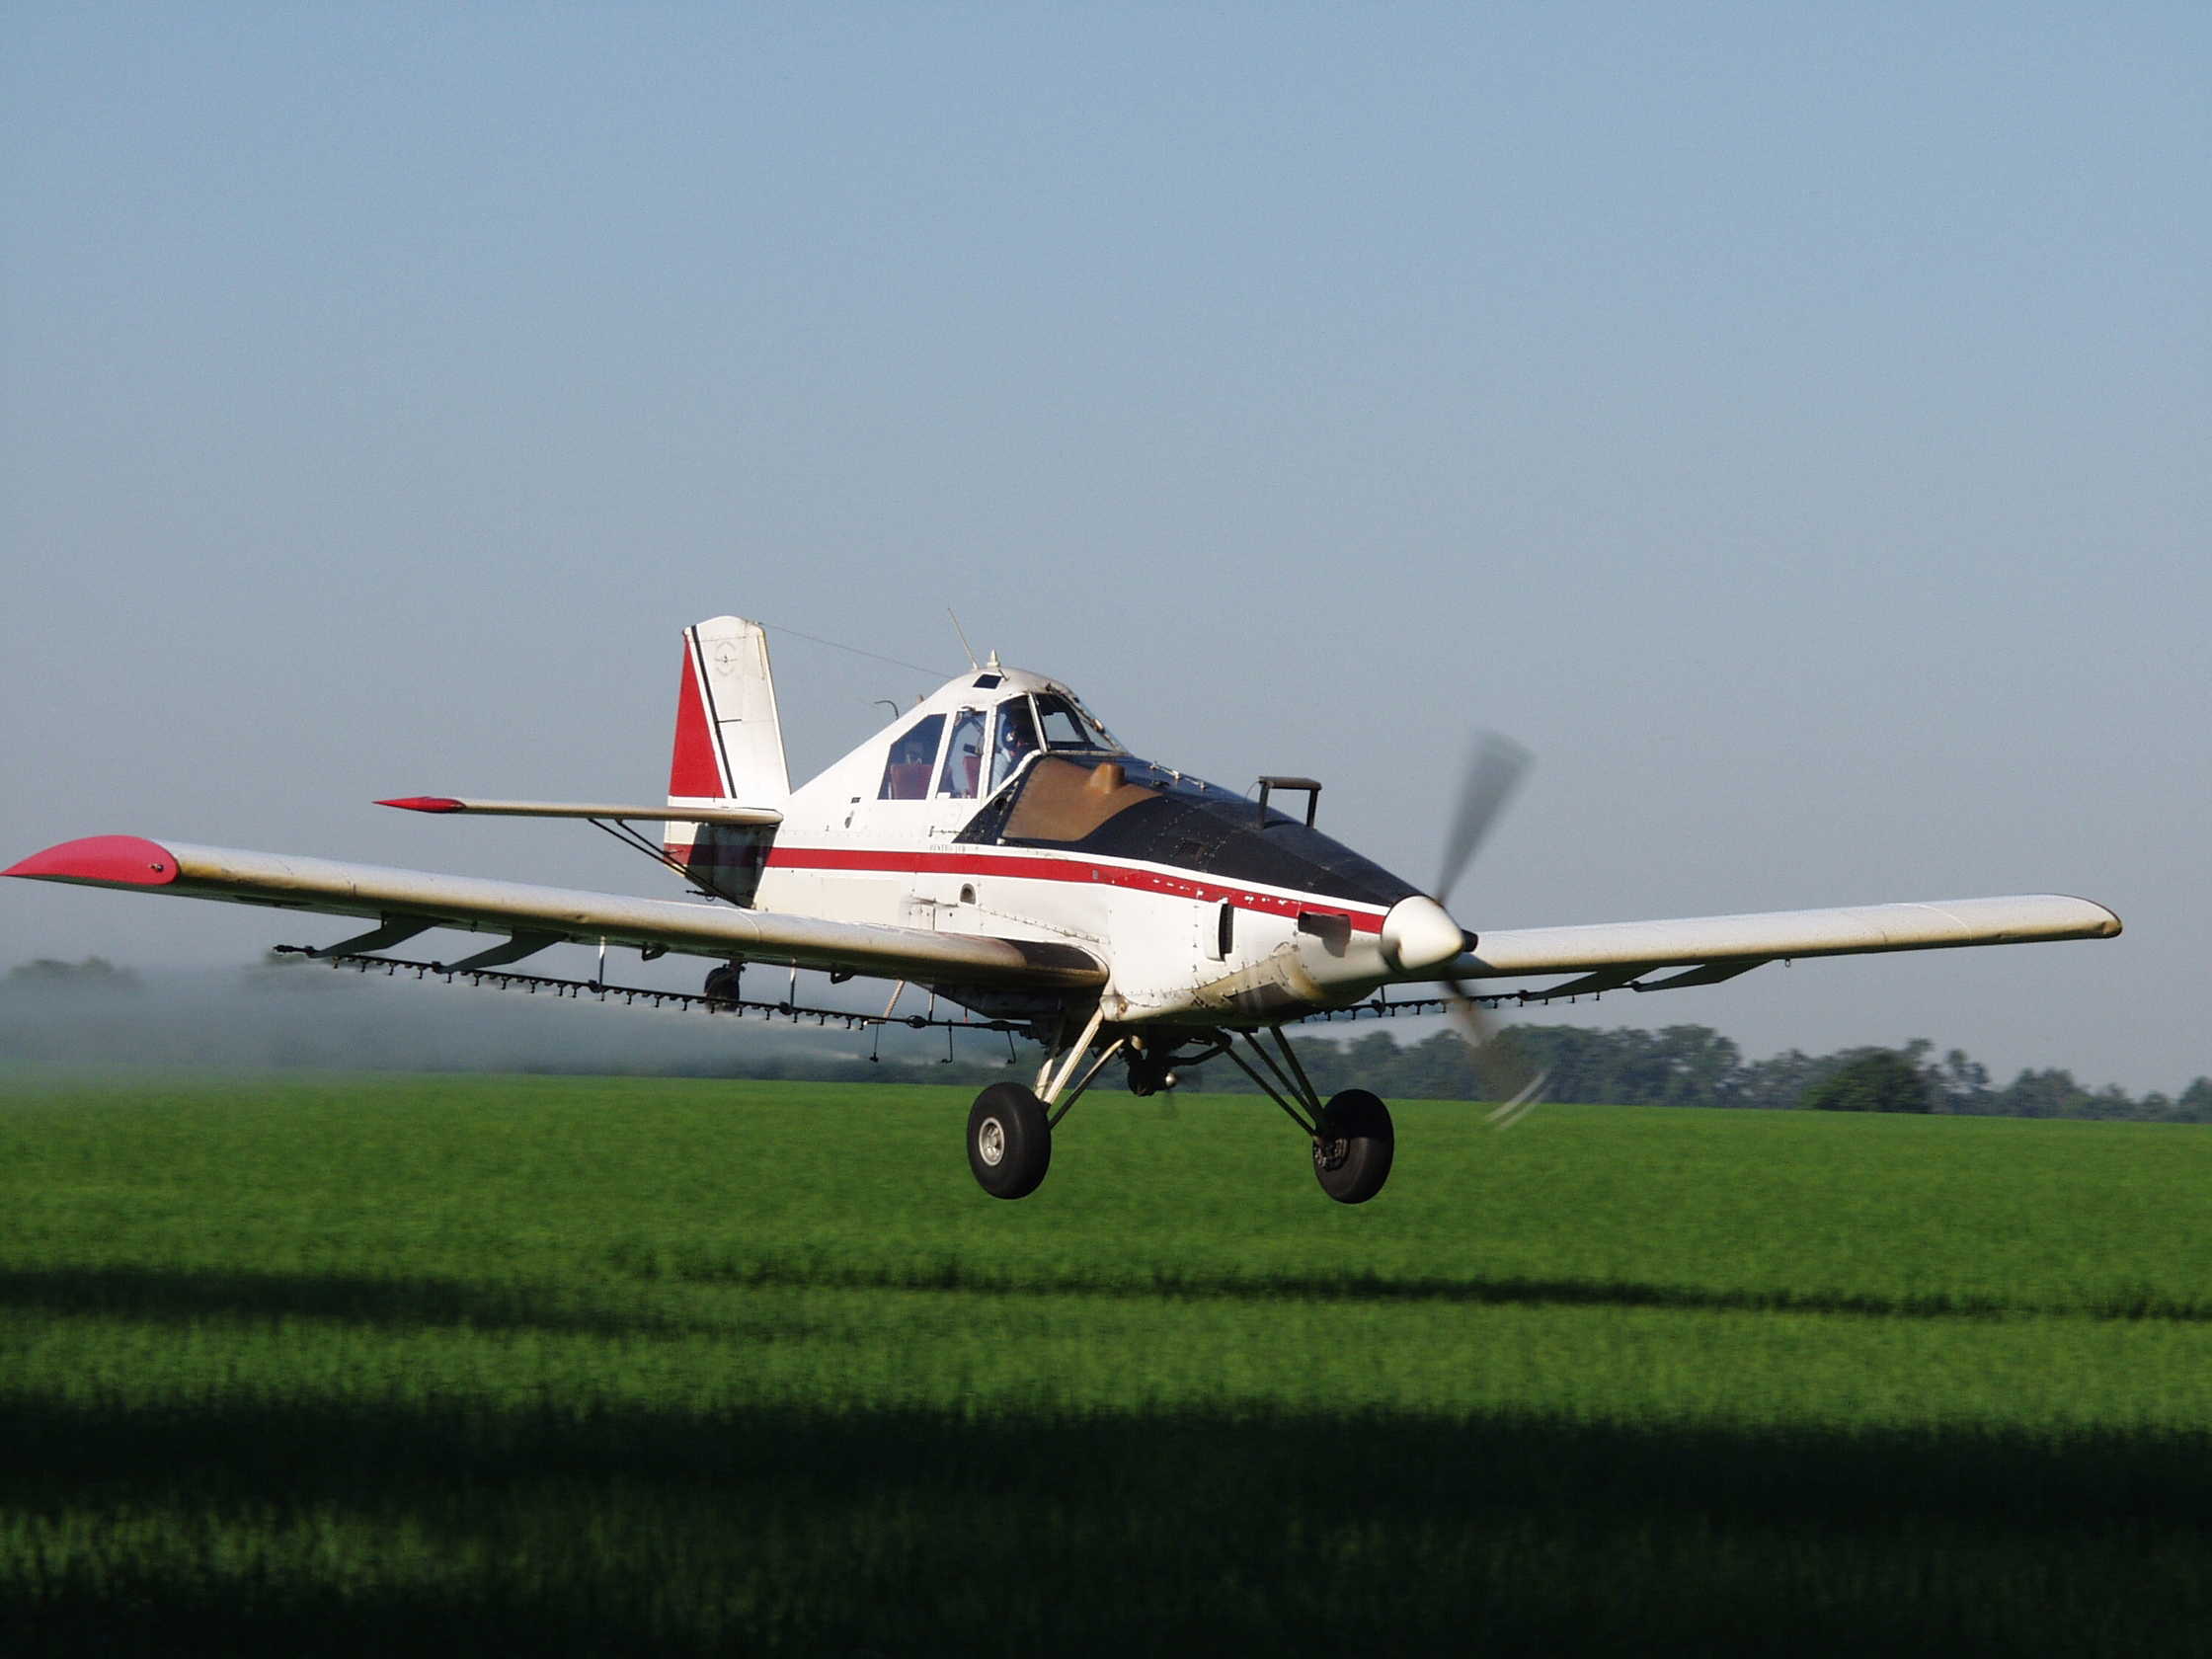
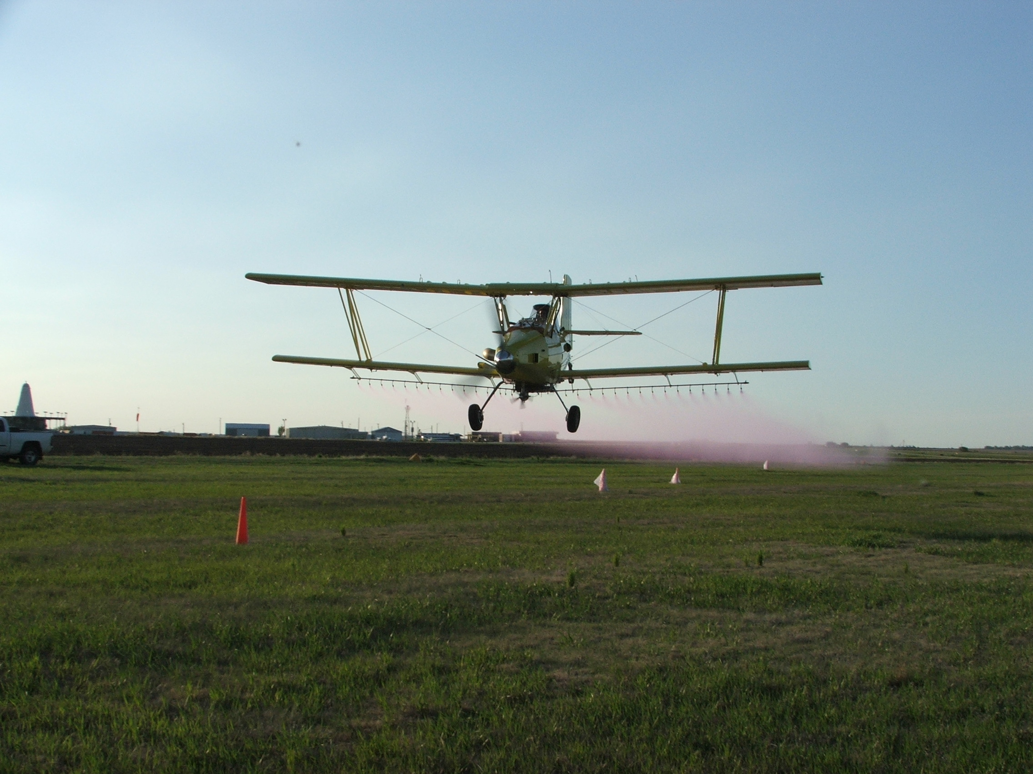
Ag Aircraft Types
83%
Fixed Wing
84% are fixed wing; 16% are rotorcraft/helicopters

Slide 26
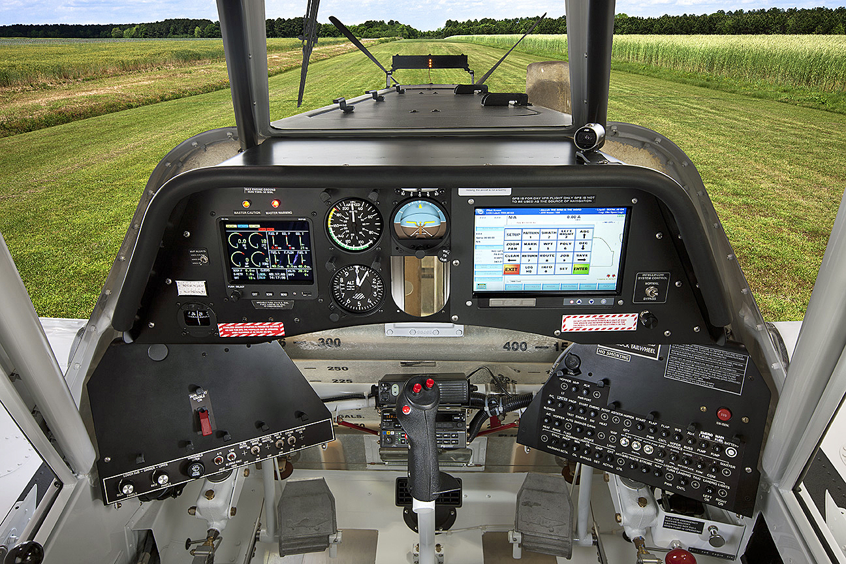
Ag Aircraft Technology
Today’s aircraft use sophisticated precision application equipment and the latest GPS technologies.

Slide 27
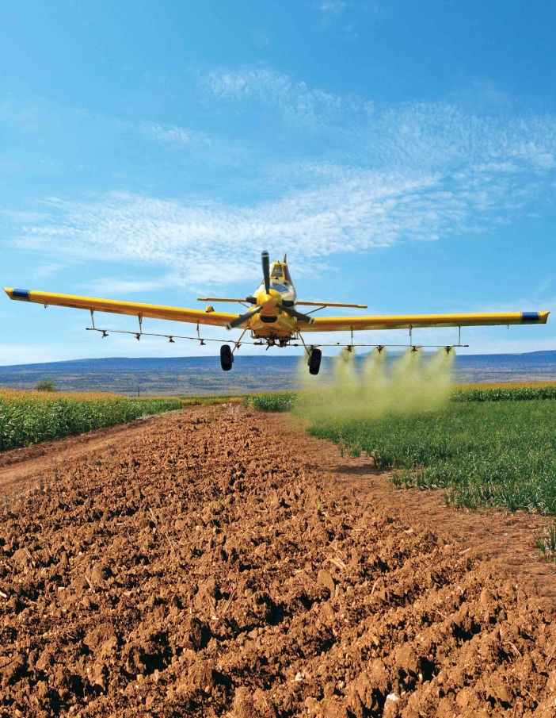
Ag Aircraft Technology
Precisely calibrated spray equipment enables less pesticide product to be applied to more acres, resulting in greater fuel efficiency and a more targeted delivery

Slide 28
Ag Aircraft Technology
GPS (global positioning systems)
GIS (geographical information systems)
Aircraft Integrated Meteorological Measurement System (AIMMS)—real-time meteorological systems
Flow control for variable-rate applications
Single-boom shutoff valves for precise applications
Smokers to identify wind speed and direction

Slide 29
Issues Affecting the Ag Aviation Industry

Slide 30
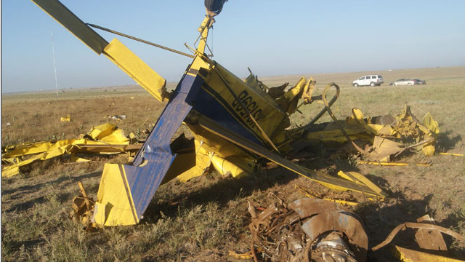
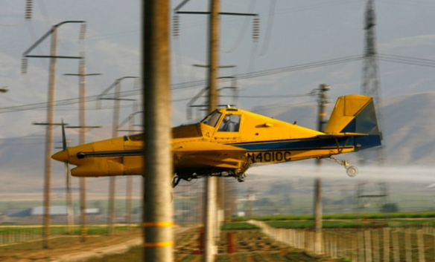
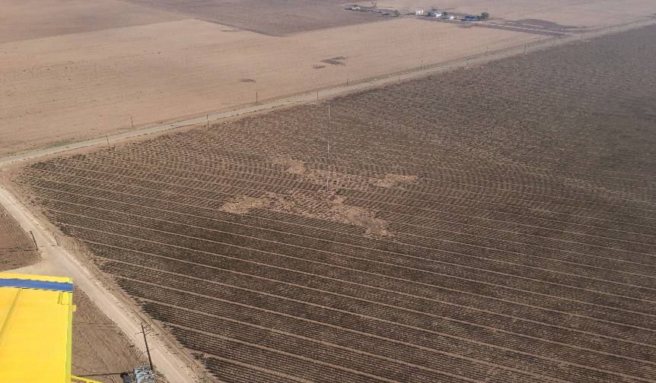
Obstacles Compromising Aerial Application Safety
Obstacle Collisions
Tower collisions caused 18 accidents (8 fatal) from 2007 to 2018
Collisions with obstacles (wires, trees, etc.) caused 242 accidents (50 fatal) from 2007 to 2018

Slide 31
Obstacles Compromising Aerial Application Safety
Wind energy, tower, landowner and farming entities are liable for not marking the tower
Congress now requires towers between 50-200 feet to be marked and logged in a public database.

Slide 32
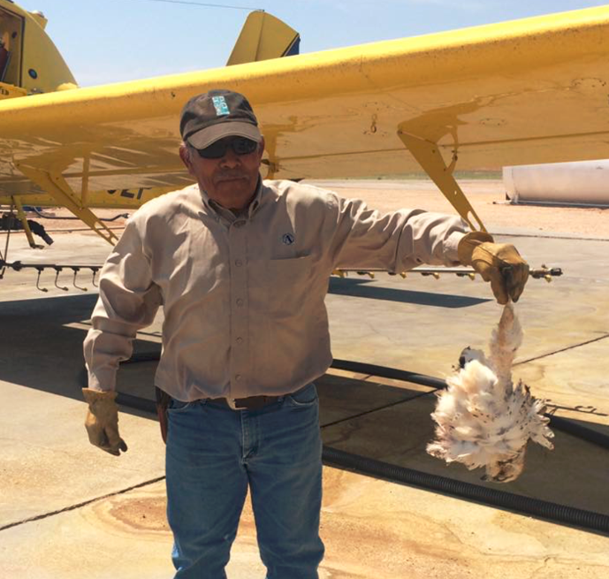
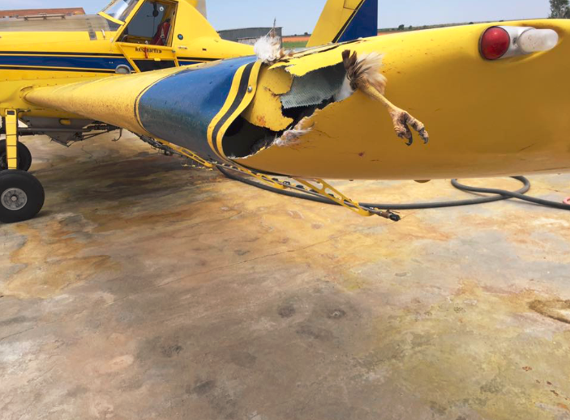
UAV-like Obstacles Compromising Aerial Application Safety
Bird Incidents
Birds are the second-leading cause of aviation fatalities.
142,000 wildlife strikes with civil aircraft in 23 years with 25 fatalities.
2.4 pounds
Notes:
In October 2015, the Colorado Agricultural Aviation Association teamed up with aviation and UAS organizations in the state to conduct a visibility test to determine if pilots can see UAVs mid-flight. The results were disconcerting; not a single pilot could visually track a six-pound, 28-inch-wide Enduro quadcopter when flying at regular speeds, and only one of six pilots were able to even spot a UAV while flying. UAVs are essentially invisible to pilots, a dangerous reality that greatly increases the chance of fatal crashes. The result of this test leads NAAA to believe that UAVs must be marked and equipped with an ADS-B Out-like system, or that UAVs and manned aircraft should not be in close proximity to one another while flying to ensure pilot safety.
This seems kind of just thrown in here
UAV’s in their current state present a hazard similar to bird strikes. At low level our current aviation system relies on the principle of two parties to “see and avoid”, these unmanned aircraft lack the ability to avoid other airspace users, increasing the risk of collision by 50% since there are half as many parties watching the sky.
Aircraft-wildlife strikes are the second leading causes of aviation-related fatalities. There have been about 142,000 wildlife strikes with civil aircraft in USA between 1990 and 2013 (about 11,000 strikes at 650 airports in 2013), with 25 fatalities. Between 1990 and 2013 62 aircraft have been completely destroyed by wildlife strikes. When adjusted for inflation and the estimated number of unreported strikes, wildlife strikes have resulted in nearly $1 billion in losses between 1990 and 2012.

Slide 33
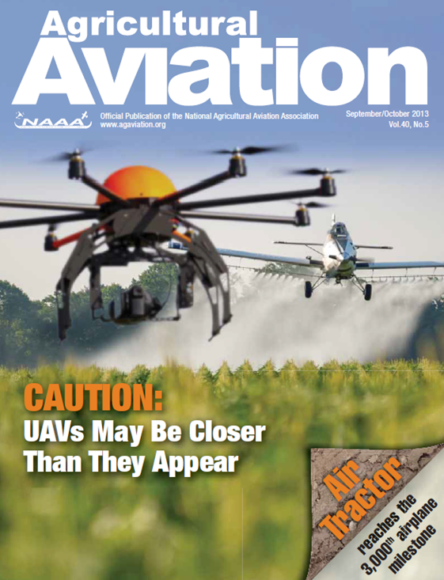
Obstacles Compromising Ag Aviation Safety
Unmanned Aerial Systems (UAVs)
Average times each day the FAA received a UAS sighting report from pilots, law enforcement or other citizens between July 1 and Sep. 30 2018
Number of UAVs the FAA predicts will be sold annually by 2020.
7.2
4.3 Million
Notes:
NAAA has a number of safety concerns regarding the integration of UAVs into the national airspace system. Due to the fact that UAVs have been legally flown for a short period of time, it’s difficult to assess their safety impact, therefore we’re forced to look at other similar threats. A comparable low-level, difficult to see hazard exists in the form of towers and wires, which were the cause of a significant number of aerial application accidents.
In June 2014, the Washington Post detailed a number of safety issues regarding large and small UAVs including lost link incidents, pilot error incidents, an a mid-air collision, many of which were small UAS at low altitudes.

Slide 34
Obstacles Compromising Ag Aviation Safety
878,000
Number of FAA registered hobbyist UAV owners as of January 2018
Number of FAA registered commercial, public and other UAV owners as of January 2018
122,000

Slide 35
Fly With Care
Get certified and well-trained in operating a UAV
Equip UAV with strobe lights and tracking
Give right-of-way to manned aircraft
Coordinate UAV operations with local aircraft operators
Carry sufficient UAV insurance

Slide 36
NAAA’s Programs and Services

Slide 37
NAAA’s Education Program
The program provides pilots continuing education about safety, security and drift mitigation
PAASS program receives EPA support and reaches approximately 2,000 aerial applicators annually
Since 1998 when PAASS first hit the stage, aerial drift incidents have decreased 26%; ag aviation accidents have decreased 20.63% per 100,000 hours flown.
Notes:
PAASS has been a remarkable success since it first hit the stage in 1998. Since that time aerial drift incidents have decreased 26 percent; ag aviation accidents have decreased 20.63 percent; state pesticide agencies offer renewal of pesticide licenses based on PAASS participation; and insurance companies offer potential premium discounts for PAASS participation.
The PAASS Program reached 1,959 attendees during the 2011–2012 season

Slide 38
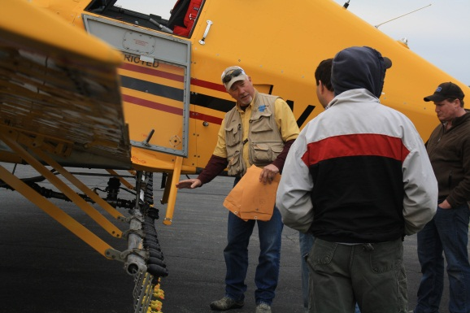
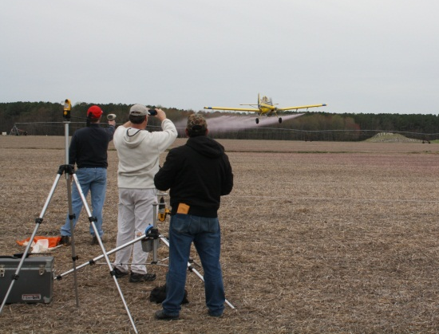
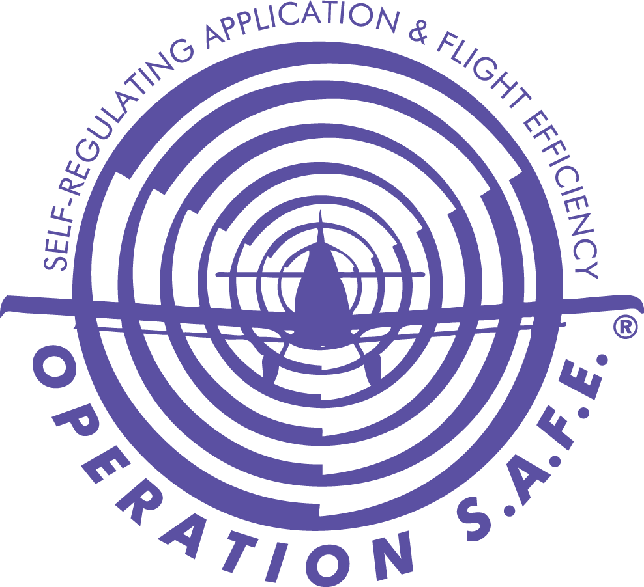
NAAA’s Operation S.A.F.E. Program
Self-regulating Application & Flight Efficiency
The Operation S.A.F.E. program enables aerial applicators to attend fly-in clinics and have their aircraft professionally analyzed for spray pattern uniformity and droplet size. This minimizes drift and maximizes the efficacy of the application.

Slide 39
NAAA’s Policy Initiatives

Slide 40
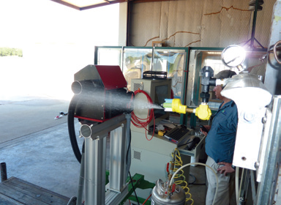
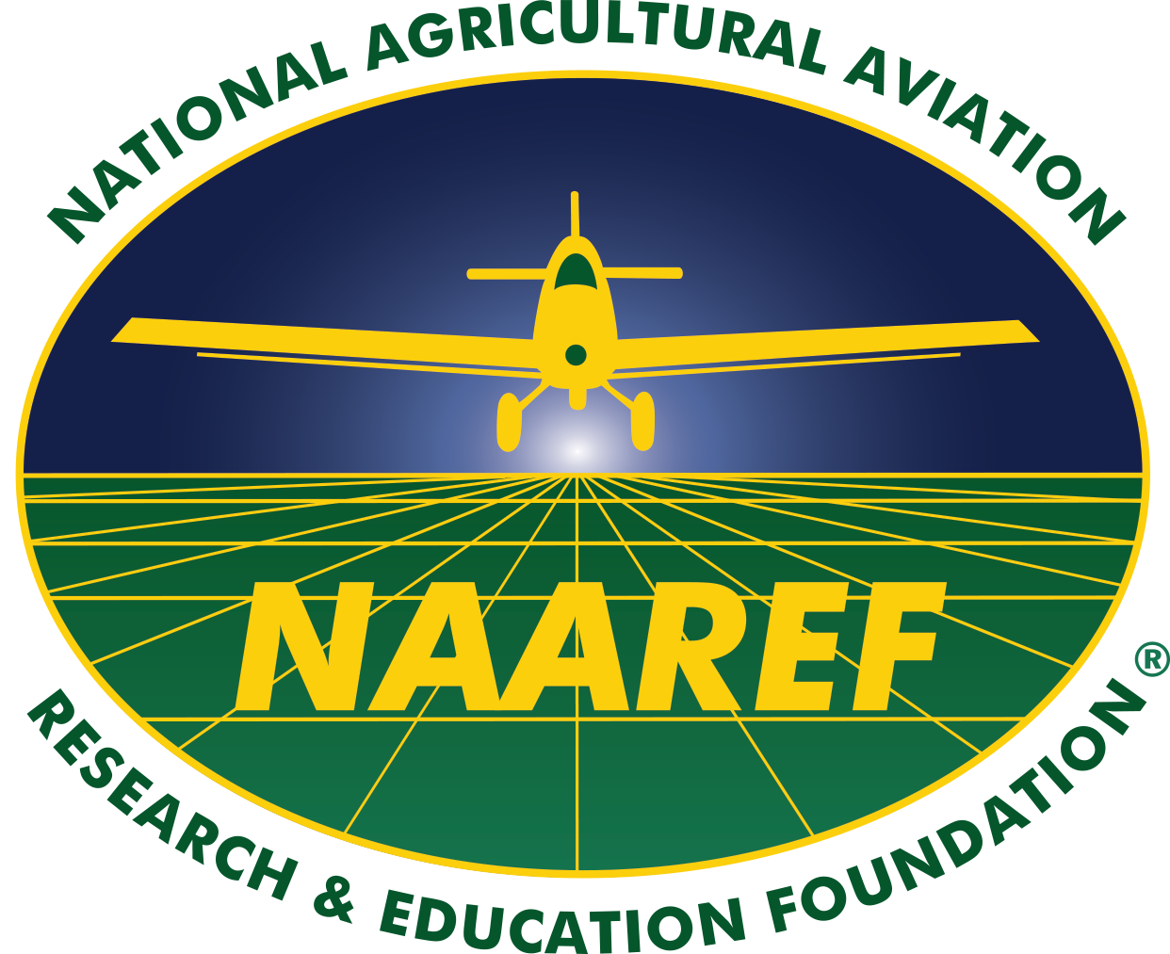
NAAA’s Priority Issues
Fund Aerial Application Technology Research
Federal funding for aerial application improves the precision and efficacy of aerial application and shows the federal government recognize that aerial application is critical to ag production
USDA economists have found that every dollar invested in ag research has a $20 return to the economy

Slide 41
NAAA’s Priority Issues
Taxes and User Fees
The majority of ag aircraft do not use public airports and rarely show up on the nation’s air traffic control system
As such, NAAA has successfully urged multiple presidential administrations and the U.S. Congress to exempt ag aviation from user fees and to preserve the federal excise tax policy affecting fuel used for ag aviation purposes.
This has resulted in the industry avoiding millions of dollars in costs each year.

Slide 42
NAAA’s Priority Issues
Registration of Crop Protection Tools for Ag Aviation
For years NAAA has worked to:
Collect data
Ensure the evolution of application technology
Educate ag aviators to ensure that the judicious application of crop protection products by air is environmentally safe
These NAAA efforts have successfully resulted in EPA (re)registering these products for aerial use.

Slide 43
NAAA’s Priority Issues
Obstacles – UAVs
Protecting ag aircraft from UAVs by advocating they be equipped with safety enhancing equipment such as lighting, tracking and ID technology.
NAAA serves on the FAA’s Drone Advisory Committee’s Subcommittee, the FAA’s UAS Safety Team and the FAA’s UAS ID and Tracking Aviation Rulemaking Committee

Slide 44
NAAA’s Priority Issues
Obstacles – Towers & Wind Turbines
Ensuring the safety of low-flying ag aircraft by preserving and implementing the marking requirements for communication towers under 200 feet.

Slide 45
NAAA’s Priority Issues
NPDES Permits
NAAA is lobbying Congress to exempt duplicative, unnecessary and burdensome NPDES permits for pesticide applications; current federal law (FIFRA) already regulates the safety of pesticide to water
www.agaviation.org/content/details-epas-npdes-pesticide-general-permit

Slide 46
Voice of the Aerial Application Industry
1440 Duke Street  Alexandria, VA 22314 (202) 546-5722  (202) 546-5726 (FAX)
AgAviation.org

